Slide 1
Bio & 241 A&P
Unit 1Lab 2

Slide 2
Histology Slides for the Epithelial, Connective, and Integumentary Tissues
Slides are presented in order of magnification
As you view the following slides make sure you can accomplish these goals:
Can you identify the tissue layers observable on the slides?
Can you identify the specific structures or layers indicated by the numbered arrows or brackets?
At the end of a sequence you will find the answers to the above for each vessel and layer.

Slide 3
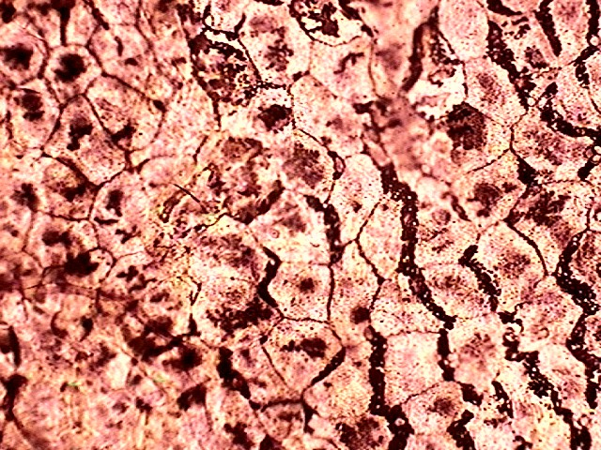
Identify cells seen in this view?
How is their shape related to function?

Slide 4
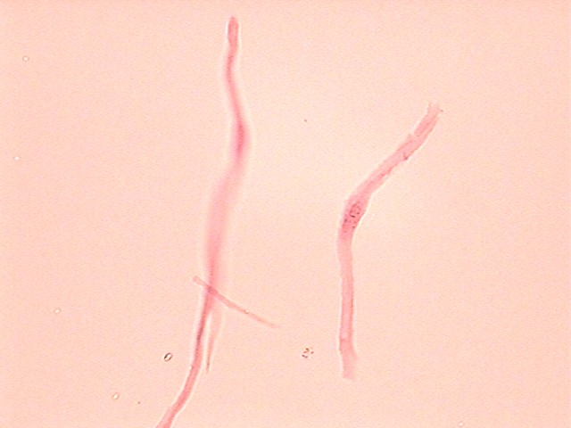
Identify cells seen in this view?
How is their shape related to function?

Slide 5
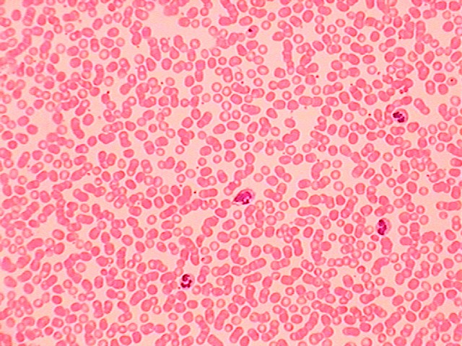
Identify cells seen in this view?
How is their shape related to function?

Slide 6
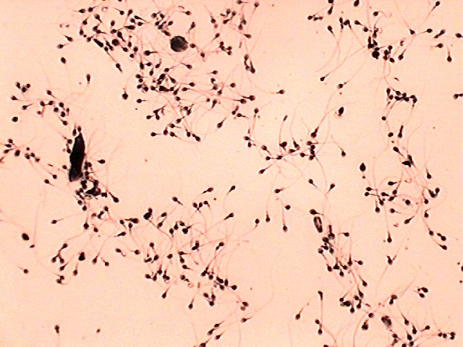
Identify cells seen in this view?
How is their shape related to function?

Slide 7
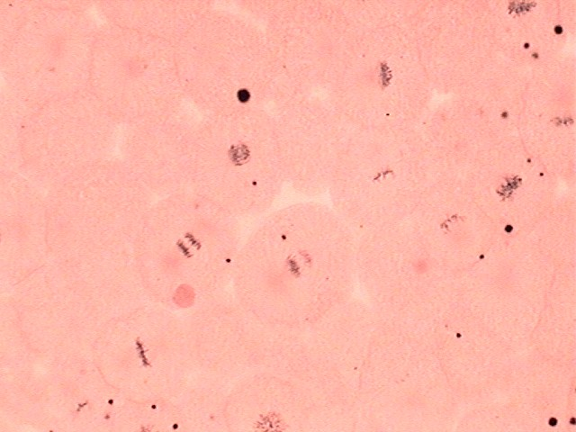
Identify stages of Mitosis
2
3
1

Slide 8
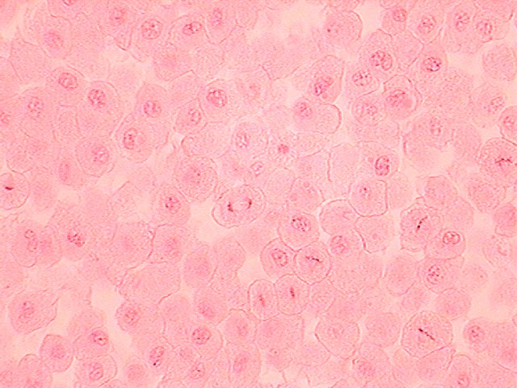
Identify stages of Mitosis
2
4
1
5

Slide 9
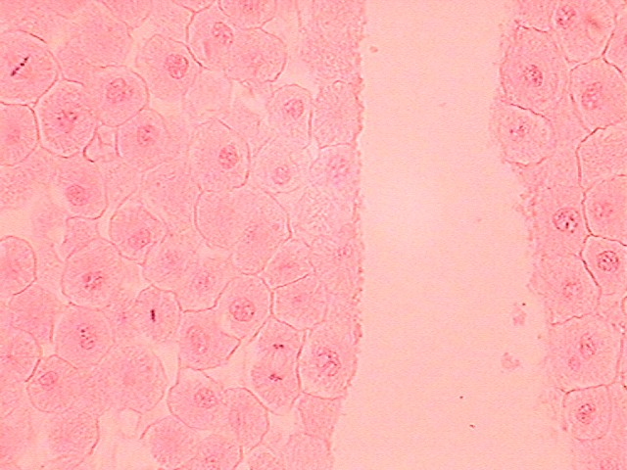
Identify stages of Mitosis
2
1
5

Slide 10
Answers to Slides 3-9
Slide 3: Surface view of simple Squamous epithelial
Cells designed to cover surfaces, have large surface area on surface plane and are thin in side view.
Slide 4: Smooth muscle cells
Cell spindle-shaped to contract and elongate on a single plane
Slide 5: Red blood cells with a few white blood cells
Biconcave to increase surface area to volume for diffusion and non-nucleated to increase hemoglobin capacity.
Slide 6: Human sperm cells
Small flagellated cells for swimming. Small size to increase the number of cells that can be placed in a small amount of solution
Slide 7-9: Mitosis of a fish egg
1. Metaphase 4. Early telophase
2. Prophase 5. Late telophase
3. Anaphase

Slide 11
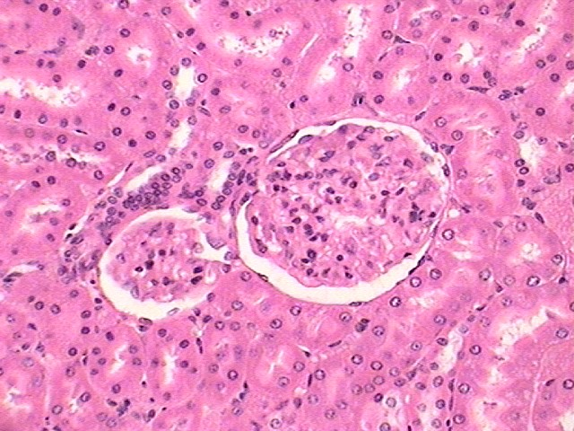
2
1

Slide 12
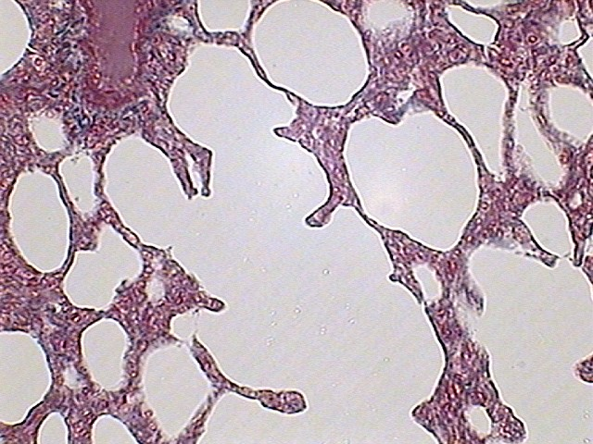
1
1

Slide 13
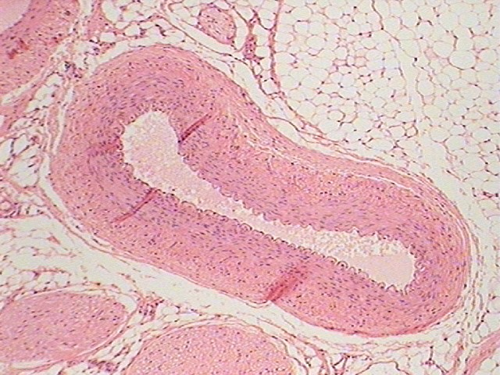
4
1
3

Slide 14
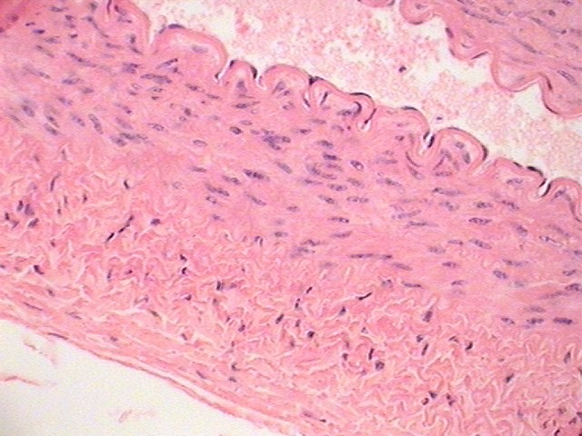
1
3

Slide 15
Answers to Slides 11-14
Slide 11: Kidney showing a renal corpuscle
Slide 12: View of lung tissue
Slide 13: Artery low power
Slide 14: Artery high power
1. Side view of simple squamous tissue
2. View of simple cubiodal
3. Dense irregular Connective Tissue
4. Adipose tissue

Slide 16
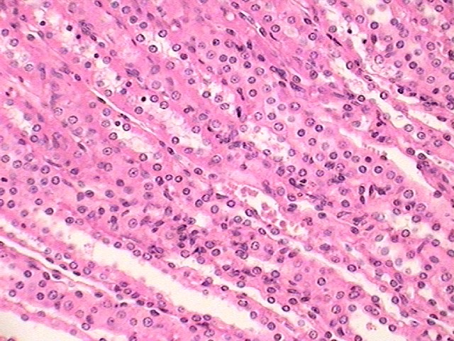
1

Slide 17
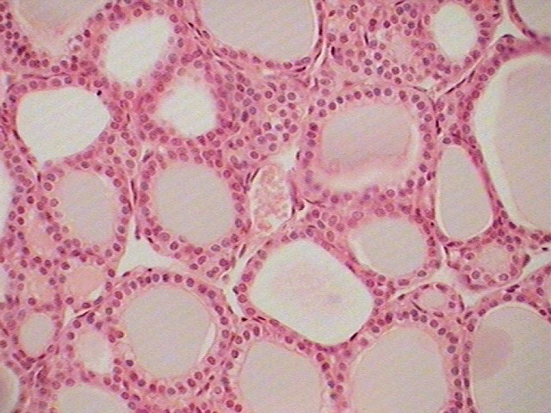
1

Slide 18
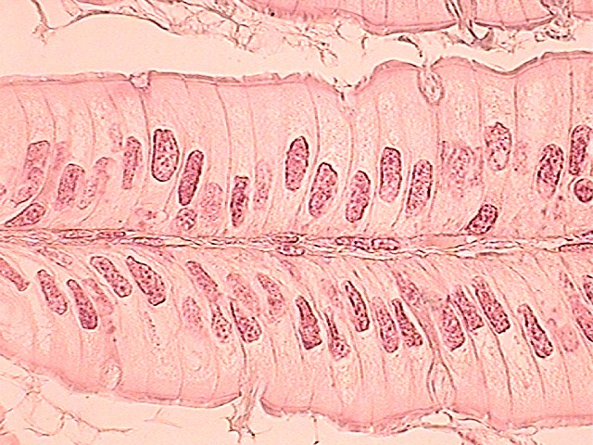
6
2

Slide 19
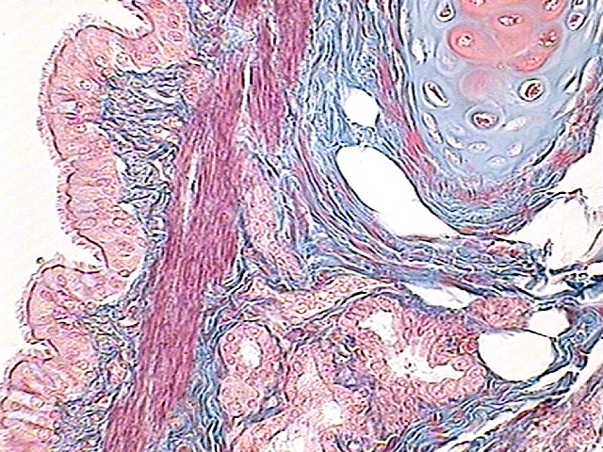
3

Slide 20
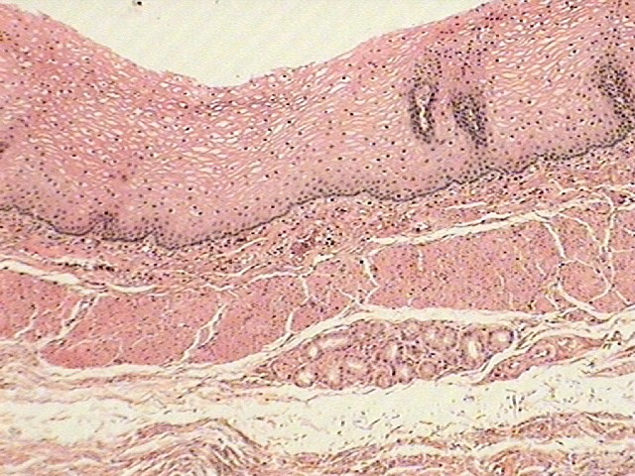
4

Slide 21
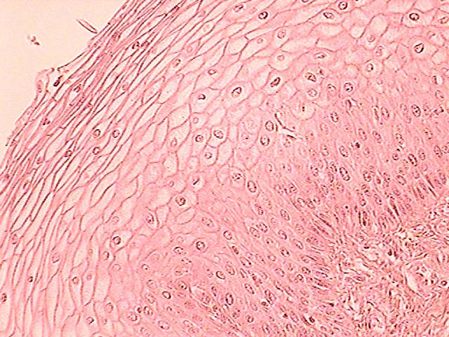
4

Slide 22
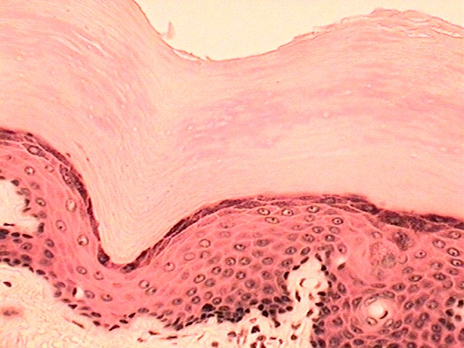
5

Slide 23
Answers to Slides 16-22
Slide 16: View showing kidney tubules
Slide 17: View of thyroid gland
Slide 18: View of small intestine villus
Slide 19: X-section through a bronchiole
Slide 20: Esophageal epithelium
Slide 21: Vaginal epithelium
Slide 22: Epidermis of non-hairy skin
1. View of simple cuboidal epithelium
2. Simple columnar epithelium
3. Pseudostratified columnar epithelium
4. Nonkeratinized stratified squamous epithelium
5. Keratinized stratified squamous epithelium
6. Goblet Cell with a mucous excretory vesicle

